Slide 1
Cell Membrane Structure & Function
Lecture 6

Slide 2
Objectives
Describe the "fluid mosaic" model of cell membrane
3 major lipids of the animal cell membrane
Phospholipid flipping and enzymes to undo flipping
Glycolipids: structure + role
Cholesterol: function in membrane
Membrane proteins (integral and peripheral) and their functional types or classes
Glycoproteins: basic structure
Glycocalyx: components + roles
Lipid rafts: general description
Cell membrane functions / purposes

Slide 3
Cell Membranes
"Plasma membranes"
the other more usual (correct?) name
Structure
role of polar lipids (phospholipids and variants)
role of proteins embedded in them or attached to them
Function
container
barrier
gate/sentry

Slide 4
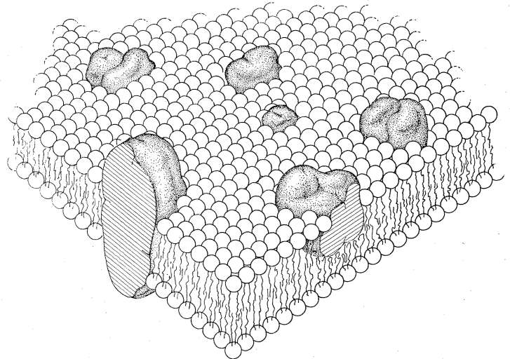
The Fluid-Mosaic Model
Not until the early 1970s did biologists get an idea of the composition of the cell membrane
Singer proposed that it was a lipid bilayer of phospholipids and that proteins bound to the membrane studded it much like a "mosaic"
The model said that all molecules (proteins and Plipids) moved transversely throughout the cell membrane, as if it were a fluid and not gelled or fixed into position
Original diagram of Singer-Nicholson model for the "fluid mosaic"

Slide 5
Membrane Lipids
Phospholipids
Glycolipids
Cholesterol
Many other types of lipids not addressed here
e.g. sphingolipids and their glycosylated forms
terpenes:

Slide 6
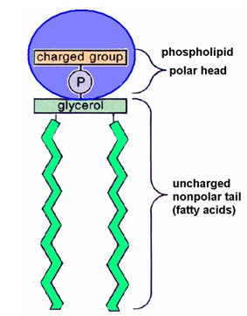
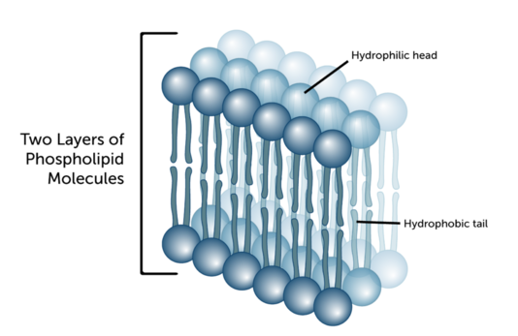
Phospholipids
The biochemistry was covered previously
Phospholipids are natural membrane formers given their polar head and hydrophobic tails

Slide 7
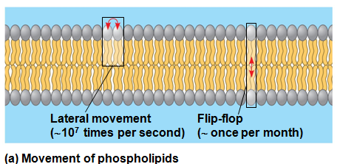
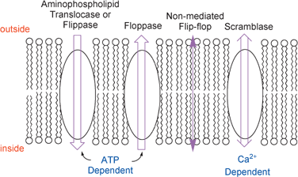
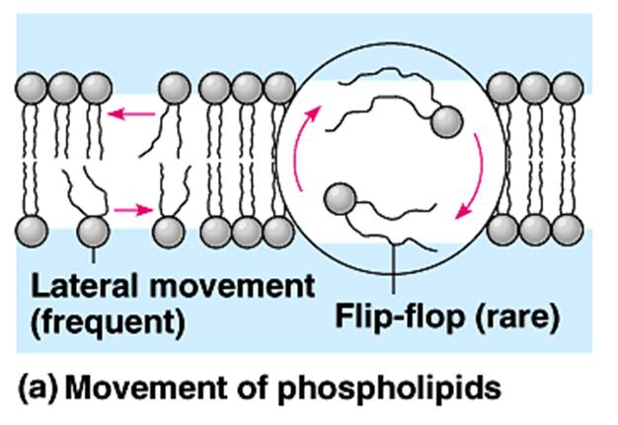
Flip-Flopping
Do phospholipids on one side traverse (flip) to the other side?
It is believed that there is one such event every 24 h (other estimates vary)
There are enzymes that typically use cell's energy to flip (=from out to in) or flop (=from in to out) the phospholipids so that they are in the correct side. These are flippases and floppases, respectively

Slide 8
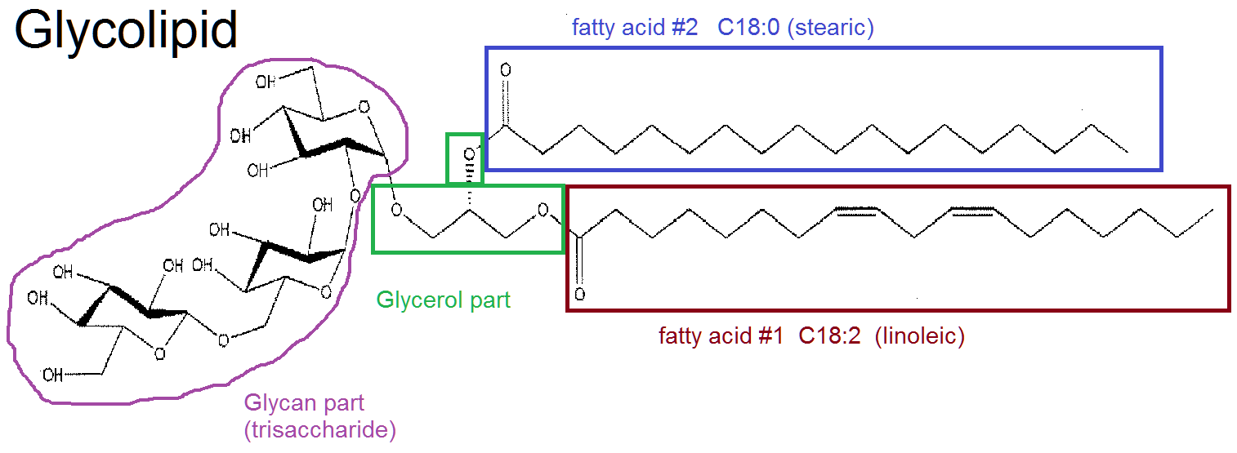
Glycolipids
5% of the membrane lipids
Oligosaccharides attach as a glycosidic bond to one of the glycerol carbons
Glycolipids are positioned on the layer opposite from the cytoplasmic layer of the membrane
Recall they are involved in cell-cell recognition (they mark the identity of the cells) and they can be used by the cell for energy

Slide 9
Cholesterol
20% of the lipid of membranes
Its single –OH group gives it slight polarity
Molecular structure is that of a flat, plate-like wall in appearance
"hardens" the membrane (reduces fluidity)
likely stabilizes cell membrane structure if there are temperature changes

Slide 10
Membrane Proteins
~50% of mass of membrane
Proteins diffuse in the plane of the membrane freely, except for proteins that make attachments to interior proteins making up cytoskeleton ("tethering")
Membrane proteins are either
integral
peripheral

Slide 11
Integral Membrane Proteins
These proteins embed or anchor themselves into the cell membrane such that they make contact with the lipid part of the membrane
Those integral proteins that span the membrane to the other side are called transmembrane proteins
The polypeptide sequences that cross through and make contact with the hydrocarbon/lipid part of the phospholipids are called transmembrane segments

Slide 12
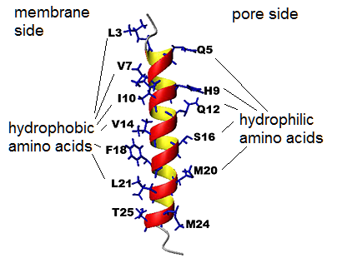
The Transmembrane Segment
As a transmembrane segment, an α-helix often passes through the cell membrane as part of the wall of an integral protein that may form a pore in the membrane
As the helix turns, the side chains of the amino acids making up the segment that face the pore (hydrophilic) side are polar or electrically charged
But side chains of the amino acids that face the membrane side & make contact with the lipophilic/hydrophobic tails of phospholipids are themselves lipophilic/hydrophobic
In the figure, notice that as the helix turns, the hydrophilic amino acids face the pore side, while those facing the membrane side have lipophilic side chains

Slide 13
Peripheral Membrane Proteins
These proteins do not have segments passing to the other side of the membrane
They may be "anchored" to the membrane by
a bond, usually covalent, to any part of a phospholipid molecule
attachment or "assembly" to a separate protein that itself is an integral protein
this attachment should not make it a part of the protein when it is first synthesized

Slide 14
Membrane Protein Functions
Integral Membrane Proteins
Receptors (transmembrane)
these bind to a hormone/ligand on outside of cell and change structure internally to start an intracellular process
Example: insulin-like growth factor I receptor
Channels (transmembrane)
pore-forming proteins that allow substances to cross in or out
Example: aquaporin
Transporters/Carriers/Pumps/Exchangers (transmembrane)
pore-forming proteins that use cell's energy or the energy of a concentration gradient to move substances against their concentration gradient
Example: Na⁺/K⁺-ATPase exchanger

Slide 15
Membrane Protein Functions
Peripheral Membrane Proteins
Cytoskeletal proteins
proteins that hook themselves to two locations: one, the membrane, and two, to a "fiber-like" linear structure inside the cell for the purpose of being part of a scaffold to arrange the internal order of the cytoplasm or to help in locomotion of the cell
Receptor-regulating proteins
proteins that attach to receptors (usually in the cell interior) to modulate (up or down) the function of the receptor

Slide 16
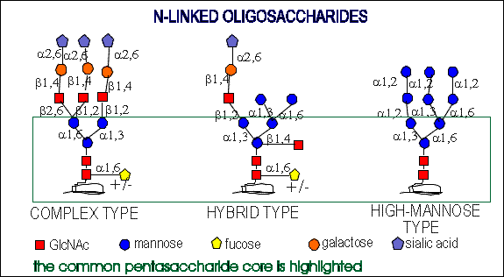
Glycoproteins
After a protein is made in the ER, it can be glycosylated with an oligosaccharide
The glycoprotein then travels through the Golgi complex where the initial oligosaccharide is trimmed of some monosaccharides, or has more added, or is modified in some way, often to put electrical charges on the monosaccharides at the end of the tails
The figure at right shows oligosaccharide structure for 3 types of N-glycoproteins
Each polymer that branches off is called an "antenna" The first one at left is called a triantennary oligosaccharide

Slide 17
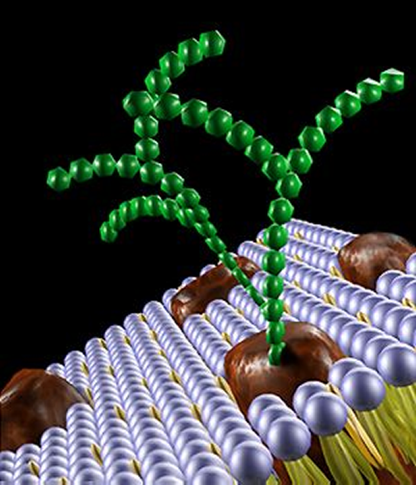
A visual look at a glycoprotein sitting in the cell membrane

Slide 18
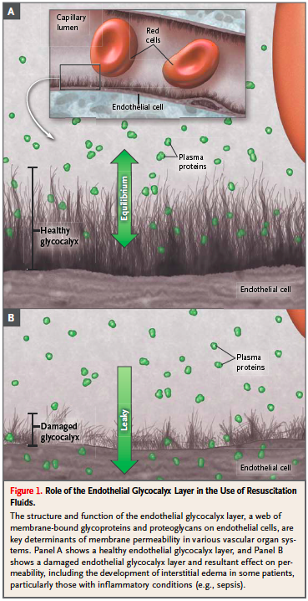
Glycocalyx
All the oligosaccharide (sugar) parts of glycoproteins & glycolipids are oriented to stick OUT of the cell (positioned on extracellular side)
This sugary goo on the outside is called the glycocalyx
This layer (looking like hairs sticking out on an electron microscope) helps cells recognize each other, among other functions

Slide 19
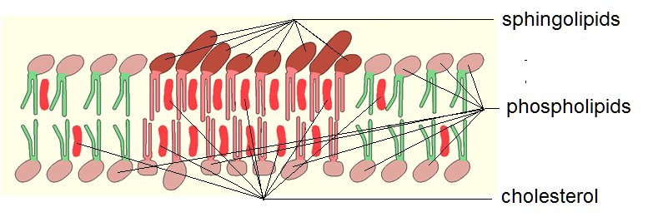
Lipid Rafts
These are membrane microdomains* composed of with concentration of sphingolipids and glycolipids on the extracellular leaf of the membrane bilayer with cholesterol molecules between them, and also surrounded by a phospholipid-rich bilayer.
The lipid hydrophobic tails in these rafts are saturated (red two-legged shapes), while the surrounding phospholipids have shorter unsaturated tails (green)
A microdomain in a membrane is one where the composition of lipids making up the local region cause the membrane to have different
packing properties, such as being more ordered or tightly packed

Slide 20
Purposes of the Cell Membrane
Physiological Container
contain all structures and biochemicals in a way that permits metabolism ("life")
Gate/Sentry
regulates the nutrients and other biomolecules that can pass
Protection
barrier to harsh chemical/physical environments
barrier infectious agents
Identity
protein markers on surface identify cell to others
Cytoskeleton
For cells capable of locomotion, works with internal cytoskeletal features to produce it
Can act as anchor to help cytoskeleton to position internal contents

Slide 21
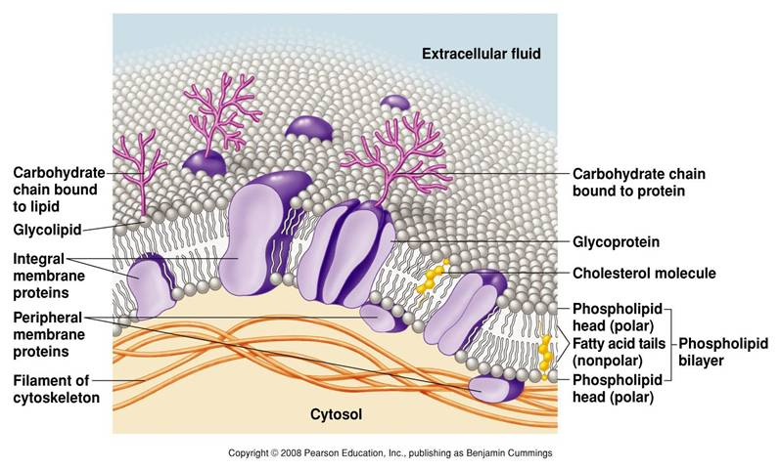
Taking it all in

Slide 22
Reading (Sources)
Becker's WotC: Chapter 7
Raven: Chap 5.1, 5.2
Marieb: Chapter 3: pp 65-66

